Slide 1
雲端計算
Cloud Computing
Infrastructure as a Service

Slide 2
Agenda
Overview
  Why do we need IaaS ?
  How IaaS meets cloud properties ?
Enabling Techniques
  Virtualization Overview
  Terminology & Taxonomy

Slide 3
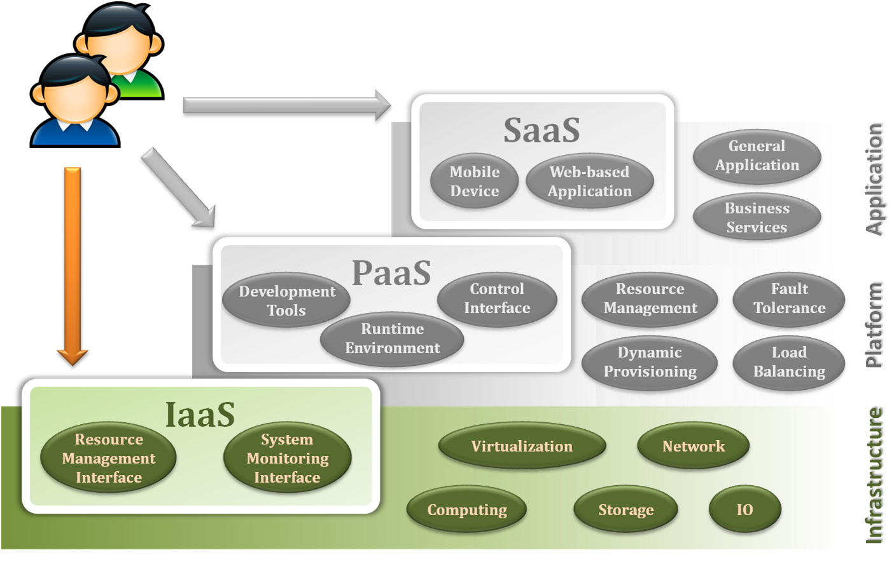
Overview
Why do we need IaaS ?

Slide 4
Overview
What is the problems in conventional case ?
  Companies IT investment for peak capacity
  Lack of agility for IT infrastructure
  IT maintain cost for every company
  Usually suffered from hardware failure risk
  …etc
These IT complexities force company back !!

Slide 5
Overview
How to solve these problem ?
  Let’s consider some kind of out-sourcing solution
    Somebody will handle on demand capacity for me
    Somebody will handle high available resource for me
    Somebody will handle hardware management for me
    Somebody will handle system performance for me
    Somebody will …
  Frankly, that would be a great solution IF there were “somebody”.
  But who can be this “somebody”, and provide all these services ?

Slide 6
Overview
Infrastructure as a Service will be the salvation.
  IaaS cloud provider takes care of all the IT infrastructure complexities.
  IaaS cloud provider provides all the infrastructure functionalities.
  IaaS cloud provider guarantees qualified infrastructure services.
  IaaS cloud provider charges clients according to their resource usage.
But, what make all of these happen so magically ?

Slide 7
Virtualization
Assume that you are going to be an IaaS cloud provider.
  Then, what are the problems you are facing ?
    Clients will request different operating systems.
    Clients will request different storage sizes.
    Clients will request different network bandwidths.
    Clients will change their requests anytime.
    Clients will …
  Is there any good strategy ?
    Allocate a new physical machine for each incomer.
    Prepare a pool of pre-installed machines for different requests.
    or …

Slide 8


Virtualization
What if we allocate a new physical machine for each incomer ?
I want Windows 7
I want Linux
I want …
Customer A
I want …
Customer B
I want …
I want …
Windows
Linux

Slide 9
Virtualization
How about preparing a pool of pre-installed physical machines for all kinds of request ?
I want Mac OS
Somebody may want
Somebody might want…
Somebody may want
Somebody might want…
Windows + Office
Windows Server
Linux + OpenOffice
Linux Server

Slide 10
Virtualization
Obviously, neither of previous strategies will work.
We need more powerful techniques to deal with that.
Virtualization techniques will help.
  For computation resources
    Virtual Machine technique
  For storage resources
    Virtual Storage technique
  For communication resources
    Virtual Network technique

Slide 11
Overview
Why do we need IaaS ?
How IaaS meets cloud properties ?

Slide 12
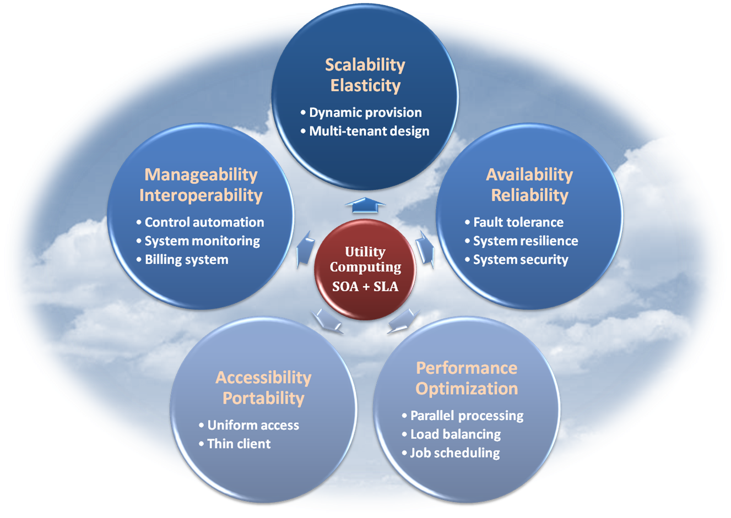
Properties and Characteristics
As a cloud provider, all of the fundamental properties and characteristics stated in previous lectures should be concerned and implemented.

Slide 13
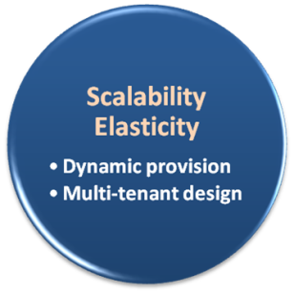
Scalability & Elasticity
What do scalability and elasticity mean in IaaS ?
  Clients should be able to dynamically increase or decrease the amount of infrastructure resources in need.
  Large amount of resources provisioning and deployment should be done in a short period of time, such as several hours or days.
  System behavior should remain identical in small scale or large one.

Slide 14
Scalability & Elasticity
How to approach scalability and elasticity in IaaS ?
  For computation resources :
    Dynamically create or terminate virtual machines for clients on demand.
    Integrate hypervisors among all physical machines to collaboratively control and manage all virtual machines.
  For storage resources :
    Dynamically allocate or de-allocate virtual storage space for clients.
    Integrate all physical storage resources in the entire IaaS system
    Offer initial storage resources by thin provisioning technique.
  For communication resources :
    Dynamically connect or disconnect the linking state of virtual networks for clients on demand.
    Dynamically divide the network request flow to different physical routers to maintain access bandwidth.

Slide 15
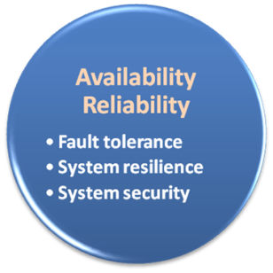
Availability & Reliability
What do availability and reliability mean in IaaS ?
  Clients should be able to access computation resources without considering the possibility of hardware failure.
  Data stored in IaaS cloud should be able to be retrieved when needed without considering any natural disaster damage.
  Communication capability and capacity should be maintained without considering any physical equipment shortage.

Slide 16
Availability & Reliability
How to approach availability and reliability in IaaS ?
  For computation resources :
    Monitor each physical and virtual machine for any possible failure.
    Regularly backup virtual machine system state for disaster recovery.
    Migrate virtual machine among physical machines for potential failure prevention.
  For storage resources :
    Maintain data pieces replication among different physical storage devices.
    Regularly backup virtual storage data to geographical remote locations for disaster prevention.
  For communication resources :
    Built redundant connection system to improve robustness.

Slide 17
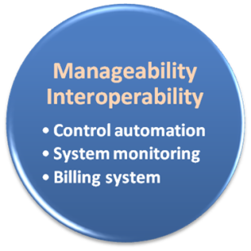
Manageability & Interoperability
What do manageability and interoperability mean in IaaS ?
  Clients should be able to fully control the virtualized infrastructure resources which allocated to them.
  Virtualized resources can be allocated by means of system control automation process with pre-configured policy.
  States of all virtualized resource should be fully under monitoring.
  Usage of infrastructure resources will be recorded and then billing system will convert these information to user payment.

Slide 18
Manageability & Interoperability
How to approach manageability and interoperability in IaaS ?
  For computation resources :
    Provide basic virtual machine operations, such as creation, termination, suspension, resumption and system snapshot.
    Monitor and record CPU and memory loading for each virtual machine.
  For storage resources :
    Monitor and record storage space usage and read/write data access from user for each virtual storage resource.
    Automatic allocate/de-allocate physical storage according to space utilization.
  For communication resources :
    Monitor and record the network bandwidth consumption for each virtual link.
    Automatically reroute the data path when computation and storage are duplicated.

Slide 19
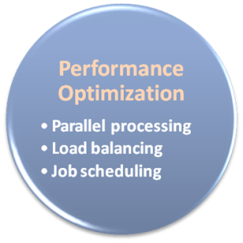
Performance & Optimization
What do performance and optimization mean in IaaS ?
  Physical resources should be highly utilized among different clients.
  Physical resources should form a large resource pool which provide high computing power through parallel processing.
  Virtual infrastructure resources will be dynamically configured to an optimized deployment among physical resources.

Slide 20
Performance & Optimization
How to approach performance and optimization in IaaS ?
  For computation resources :
    Deploy virtual machine with load balancing consideration.
    Live migrate virtual machines among physical ones to balance the system loading.
  For storage resources :
    Deploy virtual storage with hot spot access consideration.
    Live migrate virtual storage among physical ones with different performance level.
  For communication resources :
    Consider network bandwidth loading when deploying virtual machines and storage.
    Dynamically migrate virtual machines or storage to balance network flow.

Slide 21
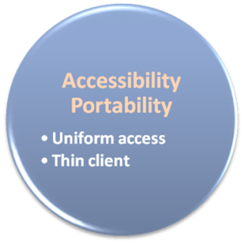
Accessibility & Portability
What do accessibility and portability mean in IaaS ?
  Clients should be able to control, manage and access infrastructure resources in an easy way, such as the web-browser, without additional local software or hardware installation.
  Provided infrastructure resources should be able to be reallocated or duplicated easily.

Slide 22
Accessibility & Portability
How to approach accessibility and portability in IaaS ?
  For computation resources :
    Cloud provider integrates virtual machine management and access through web-based portal.
    Comply the virtual machine standard for portability.
  For storage resources :
    Cloud provider integrates virtual storage management and access through web-based portal.
  For communication resources :
    Cloud provider integrates virtual network management and access through web-based portal.

Slide 23
Enabling Techniques
Virtualization

Slide 24
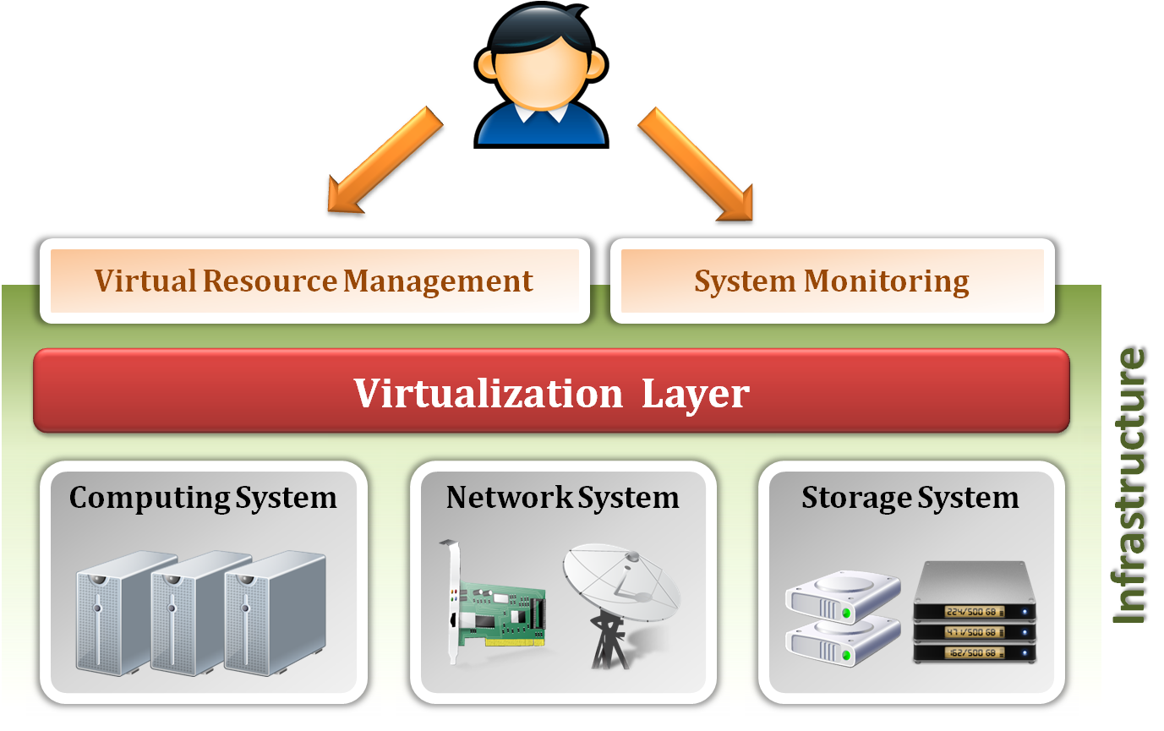
IaaS Architecture
Infrastructure as a Service (IaaS) delivers computer infrastructure for cloud user, typically a platform virtualization environment as a service.
Virtualization is an enabling technique to provide an abstraction of logical resources away from underlying physical resources.

Slide 25
Virtualization Overview
What is virtualization ?
  Virtualization is the creation of a virtual (rather than physical) version of something, such as an operating system, a server, a storage device or network resources.
  It hides the physical characteristics of a resource from users, instead showing another abstract resource.
But, where does virtualization come from ?
  Virtualization is NOT a new idea of computer science.
  Virtualization concept comes from the component abstraction of system design, and it has been adapted in many system level.
  Now, let’s take a look of our original system architecture !!

Slide 26
Virtualization Overview
System abstraction :
  Computer systems are built on levels of abstraction.
  Higher level of abstraction hide details at lower levels.
  Designer of each abstraction level make use of the functions supported from its lower level, and provide another abstraction to its higher one.
  Example
    files are an abstraction of a disk

Slide 27
Virtualization Overview
Machine level abstraction :
  For OS developers, a machine is defined by ISA (Instruction Set Architecture).
  This is the major division between hardware and software.
  Examples :
    X86
    ARM
    MIPS

Slide 28
Virtualization Overview
OS level abstraction :
  For compiler or library developers, a machine is defined by ABI (Application Binary Interface).
  This define the basic OS interface which may be used by libraries or user.
  Examples :
    User ISA
    OS system call

Slide 29
Virtualization Overview
Library level abstraction :
  For application developers, a machine is defined by API (Application Programming Interface).
  This abstraction provides the well-rounded functionalities.
  Examples :
    User ISA
    Standard C library
    Graphical library

Slide 30
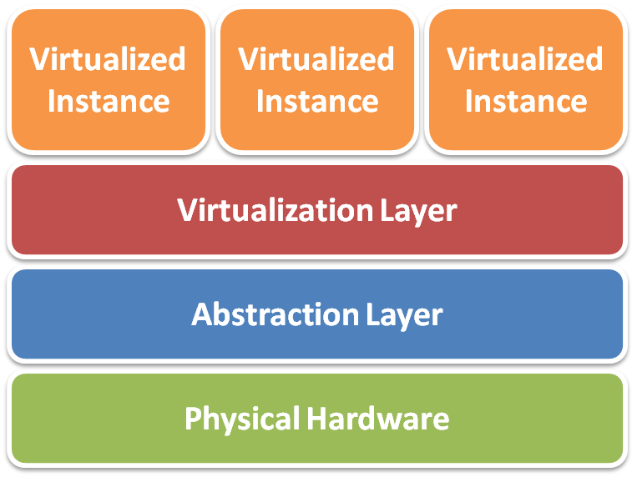
Virtualization Overview
The concept of virtualization is everywhere !!
  In IaaS, we focus the virtualization granularity at each physical hardware device.
General virtualization implementation level :
  Virtualized instance
    Software virtualized hardware instance
  Virtualization layer
    Software virtualization implementation
  Abstraction layer
    Various types of hardware access interface
  Physical hardware
    Various types of infrastructure resources
Different physical resources :
  Server, Storage and Network

Slide 31
Virtualization
Terminology & Taxonomy

Slide 32
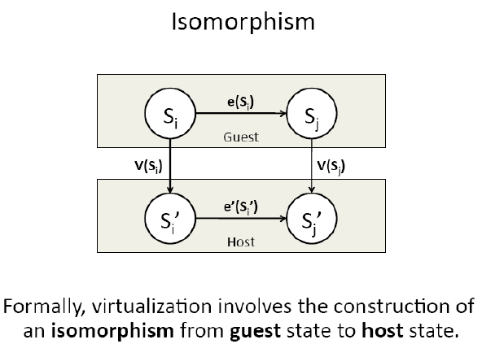
Virtual Machine
What is Virtual Machine (VM)?
  VM is a software implementation of a machine (i.e. a computer) that executes programs like a real machine.
Terminology :
  Host (Target)
    The primary environment where
    will be the target of virtualization.
  Guest (Source)
    The virtualized environment where
    will be the source of virtualization.

Slide 33
Emulation vs. Virtualization
Emulation technique
  Simulate an independent environment where guest ISA and
  host ISA are different.
  Example
    Emulate x86 architecture on ARM platform.
Virtualization technique
  Simulate an independent environment where guest ISA and
  host ISA are the same.
  Example
    Virtualize x86 architecture to multiple instances.

Slide 34
Process Virtual Machine
Process virtual machine
  Usually execute guest applications with an ISA different from host
  Couple at ABI(Application Binary Interface) level via runtime system
  Not persistent

Slide 35
System Virtual Machine
System virtual machine
  Provide the entire operating system on same or different host ISA
  Constructed at ISA level
  Persistent

Slide 36
Taxonomy
 | System Virtual Machine | Process Virtual Machine
Emulation | Transmeta Crusoe ( Emulate x86 on VLIW cpu ) | Multi-processing system
Virtualization | XEN, KVM, VMWare ( x86 virtualization software ) | JVM, Microsoft CLI ( High level language virtualization )
Techniques utilized in IaaS

Slide 37
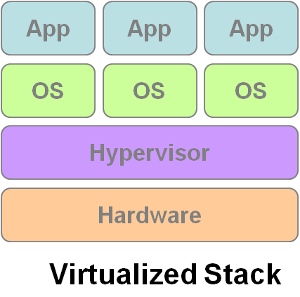
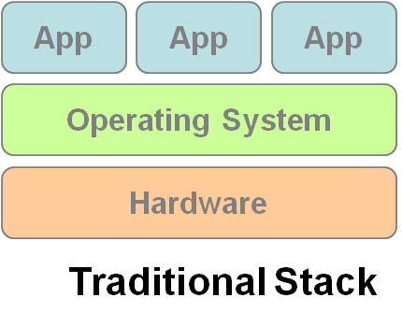
Virtual Machine Monitor
What’s Virtual Machine Monitor (VMM) ?
  VMM or Hypervisor is the software layer providing the virtualization.
System architecture :
VM1
VM2
VM3

Slide 38
Virtualization Types
Virtualization Types :
  Type 1 – Bare metal
    VMMs run directly on the host's hardware as a hardware control and guest operating system monitor.
  Type 2 – Hosted
    VMMs are software applications running within a conventional operating system.

Slide 39
Virtualization Approaches
Virtualization Approaches :
  Full-Virtualization
    VMM simulates enough hardware to allow an unmodified guest OS.
  Para-Virtualization
    VMM does not necessarily simulate hardware, but instead offers a special API that can only be used by the modified guest OS.

Slide 40
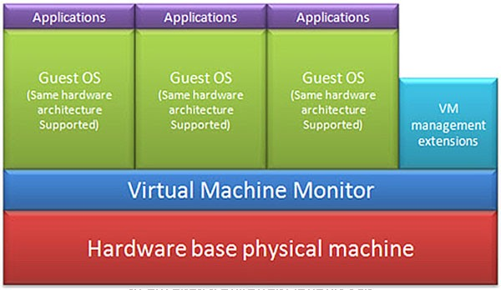
Virtualization Approaches
Full-Virtualization
Pros | Need not to modify guest OS
Cons | Significant performance hit

Slide 41
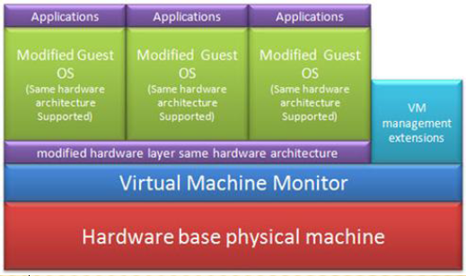
Virtualization Approaches
Para-Virtualization
Pros | Light weight and high performance
Cons | Require modification of guest OS

Slide 42
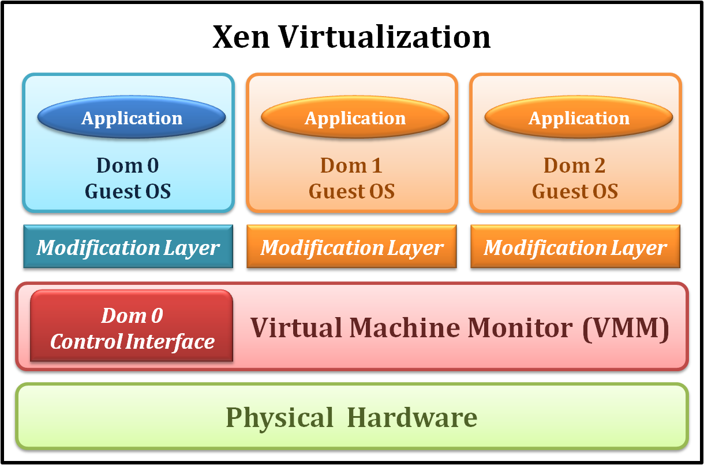
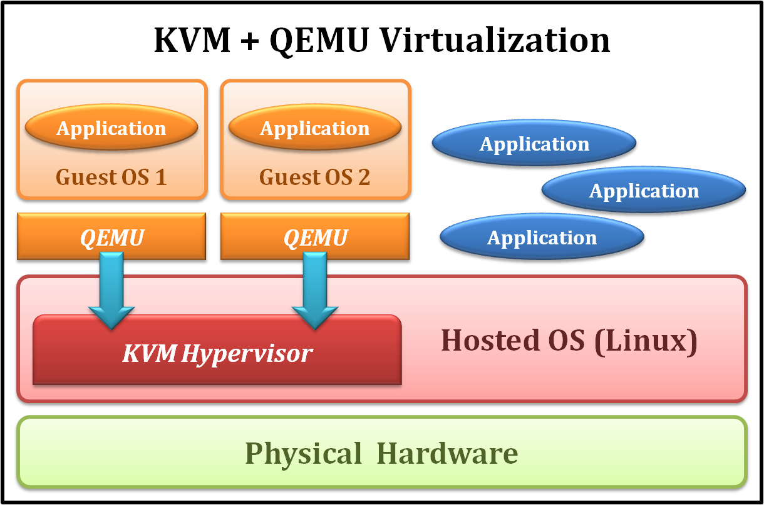
Examples
Xen
KVM
Type 1 Virtualization
Para-Virtualization
Type 2 Virtualization
Full-Virtualization

Slide 43
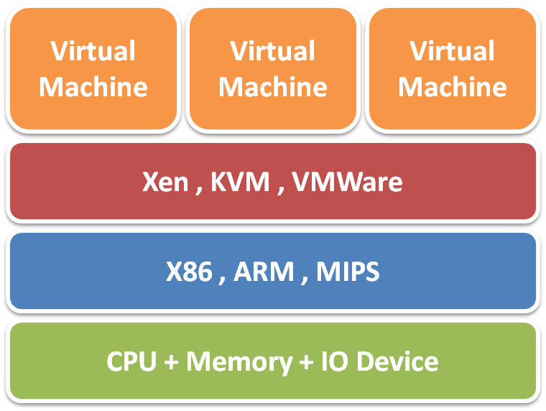
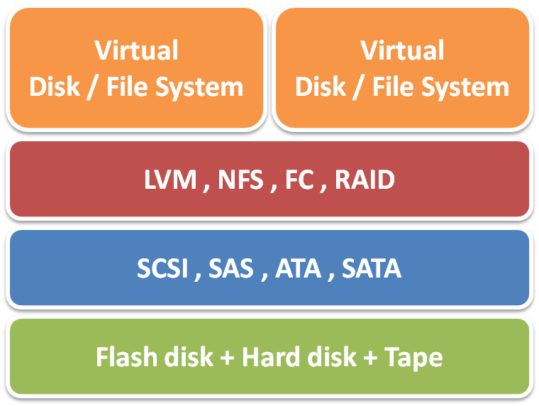
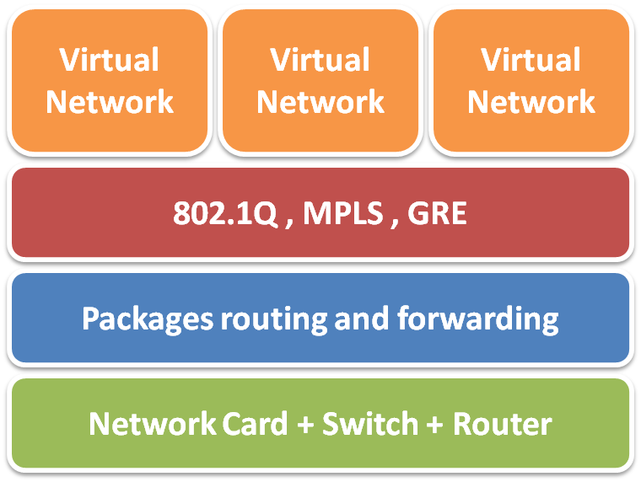
To be continued…
Virtualization techniques
Server Virtualization
Storage Virtualization
Network Virtualization

Slide 44
References
James Smith and Ravi Nair, “Virtual Machines: Versatile Platforms for Systems and Processors”.
Xen. http://www.xen.org/
Kernel-based Virtual Machine (KVM). http://www.linux-kvm.org/page/Main_Page
From Wikipedia, the free encyclopedia
All resources of the materials and pictures were partially retrieved from the Internet.

